Slide 1
MUSIC FINGERPRINTING
in MUSIC INFORMATION RETRIEVAL

Slide 2
Music Information Retrieval
A field of science for retrieving the rhythmic features from music. A combination of Signal Processing, Machine Learning, Music Study, Audio Mining, Music Notation, Artificial Intelligence.

Slide 3
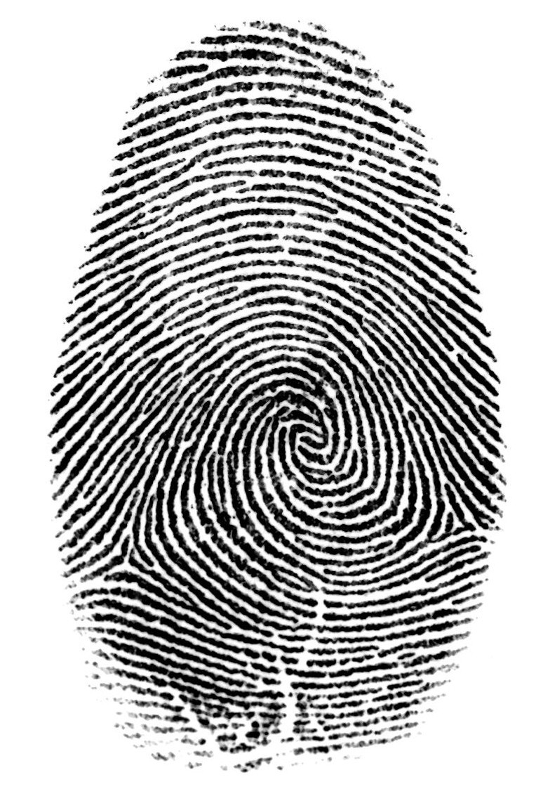
AUDIO FINGERPRINTING
An Audio fingerprint is a condensed digital summary, deterministically generated from an audio signal that can be used to identify an audio sample or quickly locate similar items in an audio database.
1
0
0
1
1
0
0
1
…
F

Slide 4
Audio Fingerprint v/s Cryptographic hash functions
Mathematical Equivalence v/s Perceptual similarity Assume X and Y are two objects that are mapped into H(X) and H(Y) by a crypto. hash function H. Strict mathematical equality of H(X) and H(Y) implies an equality of X and Y with a very low probability of error. In case of audio, we are not interested in strict mathematical equivalence but perceptual similarity.
Transitivity property If two sound tracks X and Y are perceptually similar while Y and Z are perceptually similar to each other, it does NOT imply that X and Z are perceptually similar. Transitivity property essentially holds for all mathematical hash functions.
Therefore, in stead of mathematical equivalence, we use threshold comparisons:
|F(x) – F(y) | ≤ T : implies X and Y are similar |F(x) – F(y) | > T : implies X and Y are not similar

Slide 5
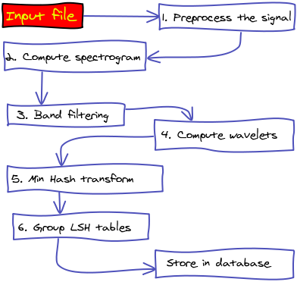
Outline
Idea
An attempt to mimic human music recognition abilities
Audio Fingerprint
Unique identifier of an audio signal
Content-based signature that summarizes an audio recording
Uses relevant (perceptual) acoustics characteristics of signal
Fingerprinting System
Database of known fingerprints
Query system

Slide 6
Points To Be Considered
Accuracy
Function of correct, missed, and wrong identifications
Complexity
Computational costs of fingerprint extraction, size of fingerprint, search complexity, comparison complexity, etc.
Robustness
Ability to accurately identify an item (no matter how compressed or distorted it is)
Granularity
Ability to identify a signal from a short excerpt
Scalability
Performance with very large databases

Slide 7
Audio Identification Framework

Slide 8
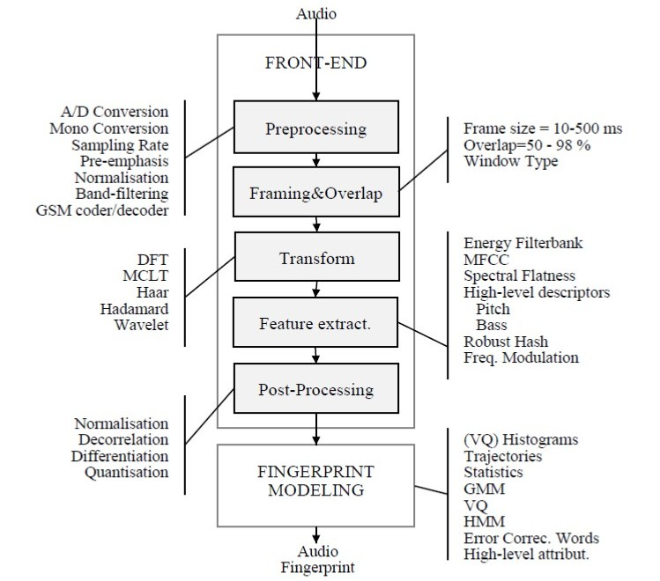
Fingerprint Extraction Framework

Slide 9
Methodology
Audio Identification Framework
Input: An Audio Sample
Output: Audio MetaData (Matched Fingerprint)
Processing:
- > Preprocessing
- > Fingerprint Extraction
- > Database Lookup
- > Distance Search
- > Audio Metadata
Fingerprint Extraction Framework
Input: An Audio File
Output: Fingerprint Hash (Digest)
Processing:
- > Segmentation
- > Compute Spectrogram
- > Feature Extraction
- > Locality Hashing
- > Fingerprint Modelling

Slide 10
Block by Block Extraction Process
For Fingerprints, the Input has to be a complete song file so that all the distinct patterns and rhythmic information can be retrieved.
The input file will be segmented into smaller and distinct segmental patterns and a list of those patterns will be returned.
The segmented pattern list will be used to compute and plot the Spectrograms.
Also, the above list will be used to extract the rhythmic features from the segments of the song.
A Hashing Mechanism known as Locality Sensitive Hashing will be applied on the features to get the digest of the patterns.
At Last, Fingerprint Modelling will be done to store the unique digest (hash) in our database.
The following features will be retrieved for Fingerprinting:
Zero Crossing Rate, Sample Rate, Spectral Centroid, Chromagram, Onset Rate, LogAmplitude

Slide 11
Block by Block Identification Process
The Input will be either a direct audio file or through speech recognition on the real time (it can be a complete song or minimally must be a 10 sec long clip).
The Fingerprint Extraction Framework will be used to extract the rhythmic features of the audio file provided.
The Database Lookup and Match will be performed for audio fingerprint extracted above with the existing fingerprints in the database.
The Matching will involve a Nearest Neighbor Search to identify the closest and most similar fingerprint existing in the database.
The above step will return a list of song fingerprint matched with their corresponding accuracy in the ascending order.
The fingerprint with the higher accuracy will be considered as the matched item, and hence will be returned with its Metadata.

Slide 12
Existing Applications
Example Systems
- Shazam
- SoundHound
Locality Sensitive Hashing (LSH)
- Winner Take All Hash
- MinHash

Slide 13
Lets Talk Shazam
Recognize a song from a short snippet of audio recorded on a mobile phone.
–Database of nearly 2 million tracks
–Recorded snippet up to 15 seconds in length
“Combinatorically hashed time-frequency constellation analysis”

Slide 14
Applications
Identify Songs, Melodies
Detect Cover Songs
Group Similar Songs
Build Song Playlist
What makes us different?
All the existing applications like Shazam and Soundhound is about exact audio song match, but our program not only matches the same song but also its similar songs like cover and duplicates, and also sort them according to their similarity percentage, which serves as a variety to the result.

Slide 15
References
Jaap Haitsma and Ton Kalker, “A highly robust audio fingerprinting system”, Philips Research , Eindhoven, The Netherlands, October 2001
Music IP corporation, Available HTTP: musicip.com
Haitsma J., Kalker T. and Oostveen J., “Robust Audio Hashing for Content Identification”, Content Based Multimedia Indexing 2001, Brescia, Italy, September 2001.

